Slide 1


AN AMERICAN RESTAURANT IN
Coursera Capstone
IB M APPLIED DATA SCIENCE
NEW YORK CITY
By – Josep Palomino
July 2021

Slide 2

Business Problem
Select the best location to open an American Restaurant in New York City
Provide a solution to start a new American Restaurant in the city
Business keep growing for upcoming years

Slide 3
Data required
List of Boroughs and neighbourhoods of New York
Latitude and longitude co-ordinates of those neighbourhoods
Venue data particularly data related to restaurants

Slide 4
Sources of Data
Opensource dataset of New York: https://cocl.us/new_York_dataset
Geocoder package for latitude and longitude co-ordinates
Foursquare API for venue data

Slide 5
Methodology
Collect the data from https://cocl.us/new_York_dataset
Clean and process the data into data frame
Locate all venues by using Foursquare API
Filter by american restaurants – their ratings, likes, tips by users
Sort the data based on rankings
Assess data visually using graphings

Slide 6
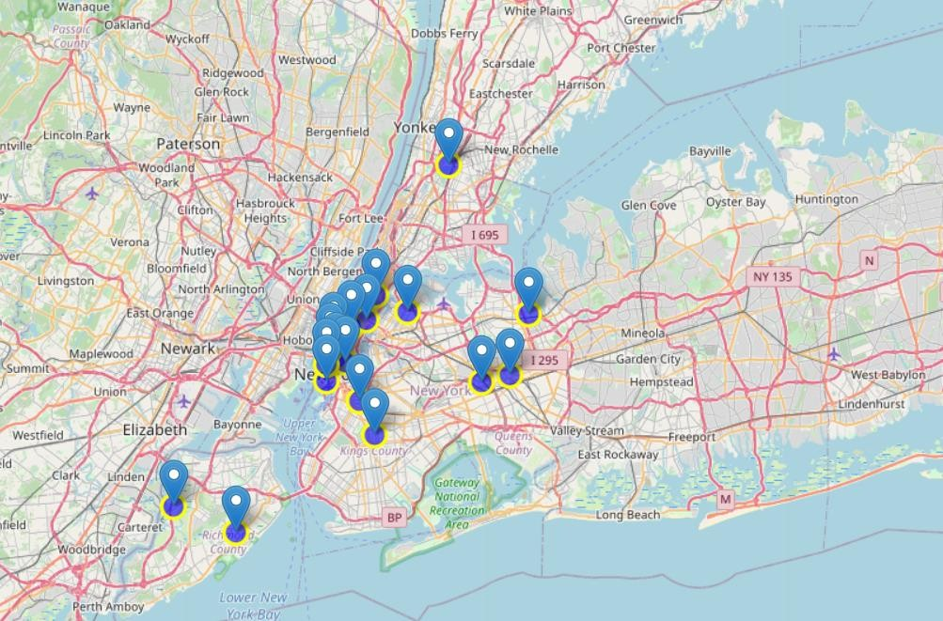
Results
Manhattan has the highest number of american restaurants comparing to other boroughs.
Staten Island has the highest average rating
for american restaurants.
Two neighbourhoods with the highest average rating for american restaurants are Tribeca located
in Manhattan and Astoria located in Queens.

Slide 7
Discussion Section
Based on the results of our analysis, Manhattan & Staten Island are the best locations for american restaurants in New York city.
Brooklyn is the best place to open a new american restaurants.
Neighbourhoods Greenwich Village & Sutton Place are the best place to open a new american Restaurant.

Slide 8
Conclusion
Got an answer to the question: Where should the investor open an american restaurant in New York city ?
Best rated american restaurant in NYC is The Kati Roll company in Manhattan.
The findings of this project may be used in real life to better understand the advantages and disadvantages of different New York neighbourhoods/ boroughs in terms of opening an american restaurant.

